Slide 1

Application of Machine Learning / Deep Learning in Finance / Investment
Jacky Chow (Jie Zou)

Slide 2

agenda
agenda
Part I. Background in Big Data and AI
Part II. Case Study – Coronavirus
Part III. Major Applications:
- digital and personalized health
- new drug discovery and drug development
- genomics
- radiology
- population health and disease management
- medical insurance
Part IV. Discussion Panel
Part I. What?
Part II. Why?
Part III. How？
Part IV. Conclusion

Slide 3

Part 1. What？
This Photo by Unknown Author is licensed under CC BY-SA

Slide 4
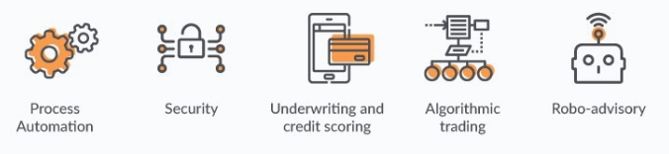
What financial application areas are of interest to DL community?
ML/DL Use Cases in finance

Slide 5
Programmatic Trading &&Decision Support Systems
— 1.1 Financial / invested programmatic trading
based on the Trend Investment Methodology. They believe that ‘Whatever has happened before will happen again. Whatever has been done before will be done again.’ They only care about prices and trends, not intrinsic values and current market valuations.
‘There’s nothing new under the sun’. This is mainly an investment / trading methodology based on trading psychology and analysis of trends.
— 1.2 Decision Support Systems
based on the Value Investment Methodology. They believe that fundamental analysis can help to identify the value opportunities of stock in. They do not care about short-term prices and trends, and focus on the intrinsic value of the company, but buying and selling will also consider the current market valuation and other factors, the safety margin is important.(Warren Buffett)
It does not directly operate transactions, but provides support for transaction decisions.

Slide 6
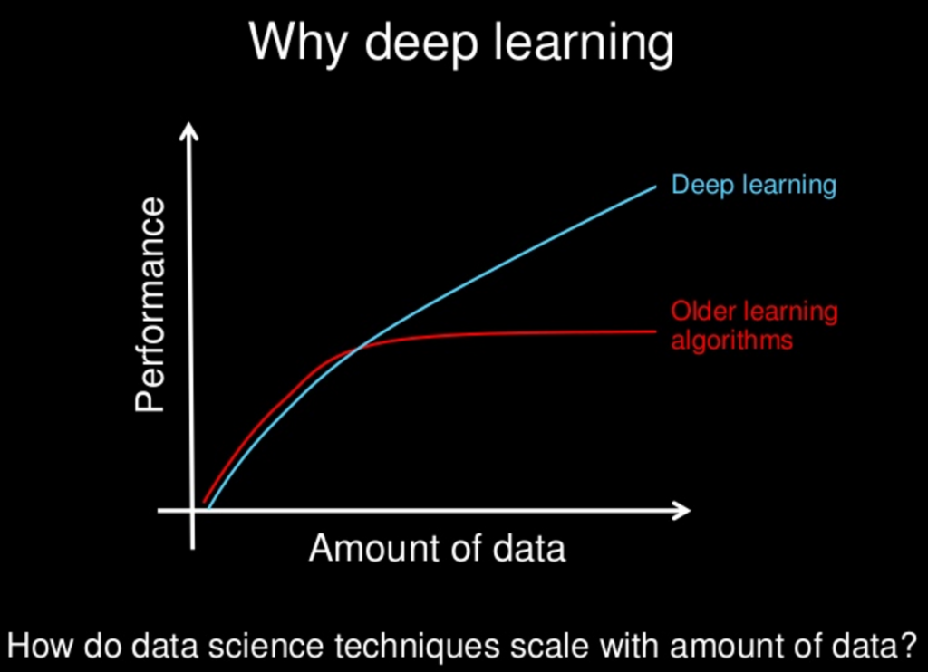
Part II. Why？
In the field of machine learning(ML), Numerous studies have been published resulting in various models. And deep learning (DL) has recently begun to receive Widely concerned, this is mainly due to its better performance than the classic model. [2]
“Deep Learning for Financial Applications: A Survey” (source: https://arxiv.org/abs/2002.05786):
6
This Photo by Unknown Author is licensed under CC BY-SA

Slide 7

Part ii. Why?
The final output of a trading strategy should answer the following questions
DIRECTION:
Identify is going rise of going down (or identify if an asset is cheap/expensive/fair value)
ENTRY TRADE: Identify the timing of buy trade(or if an asset is cheap/expensive, should you buy/sell it)
EXIT TRADE:
Identify the timing of sell trade, should you exit that position)
PRICE RANGE: Which price (or range) to make this trade at
QUANTITY: Amount of capital to trade(example shares of a stock or percent of funding)
ML or DL can be used to answer each of these questions---- both for Programmatic Trading and Decision Support Systems.

Slide 8
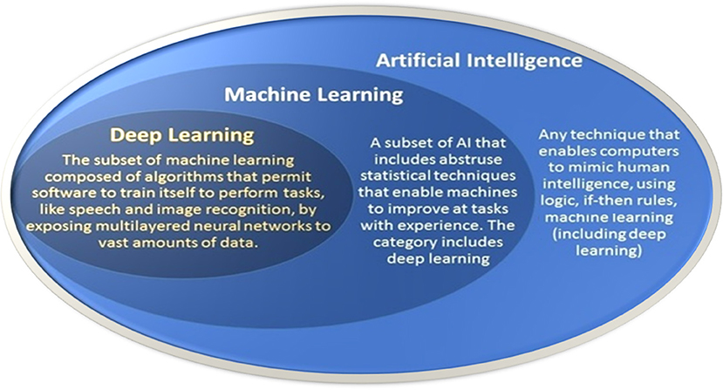
Part ii：Why？
Data is the life of ML/DL
In general, the more data you feed, the more accurate are the results in ML/DL.
Coincidentally, there are huge datasets in the financial services industry, such as petabytes of data on transactions, customers, money transfers, news, reports.
This Photo by Unknown Author is licensed under CC BY

Slide 9
Part iii: how?
Our focus was on DL implementations for financial applications
Main:
From Survey
“Deep Learning for Financial Applications:
A Survey”
I will introduce other studies of the applications of ML/DL in the financial / investment field on similar topics, such as:
— Application of Deep Learning to Algorithmic Trading
— Stock market index prediction using artificial neural network
— Use of emerging technologies for investment in programmatic trading
— Machine Learning for day-trading
— Deep Learning-trading-hedge-funds
— The application of deep learning in foreign exchange trading

Slide 10
Part iII. How ?
How to use DL in Finance / Investment ?
Application domains
1
3
Bayers’ theorem
2
4
Develop trading strategy;
Compare them;
Performance show;
Deep learning (DL) models

Slide 11
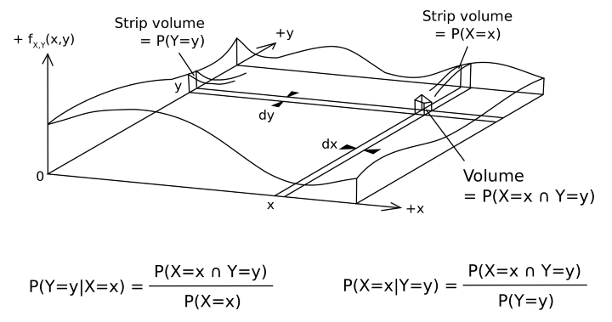
Part iII:How?
The basis of price prediction is probability theory and statistics, one of the most important assumptions is the Bayers’ theorem.
1
Bayers’ theorem

Slide 12
Part iII:How?
The proposed deep learning (DL) models that the source
papers have used for their research.
Convolutional neural network(CNN)
Recurrent Neural Networks（RNN)
Long Short Term Memory (LSTM)
Deep Belief Networks (DBNs)
2

Slide 13

Convolutional neural network(CNN)
Typical CNN architecture

Slide 14
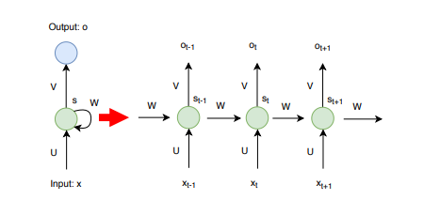
Recurrent Neural Networks（RNN)
In contrast to feed-forward neural networks, in recurrent neural networks, data can flow in any direction. They can learn the time series dependency well.

Slide 15
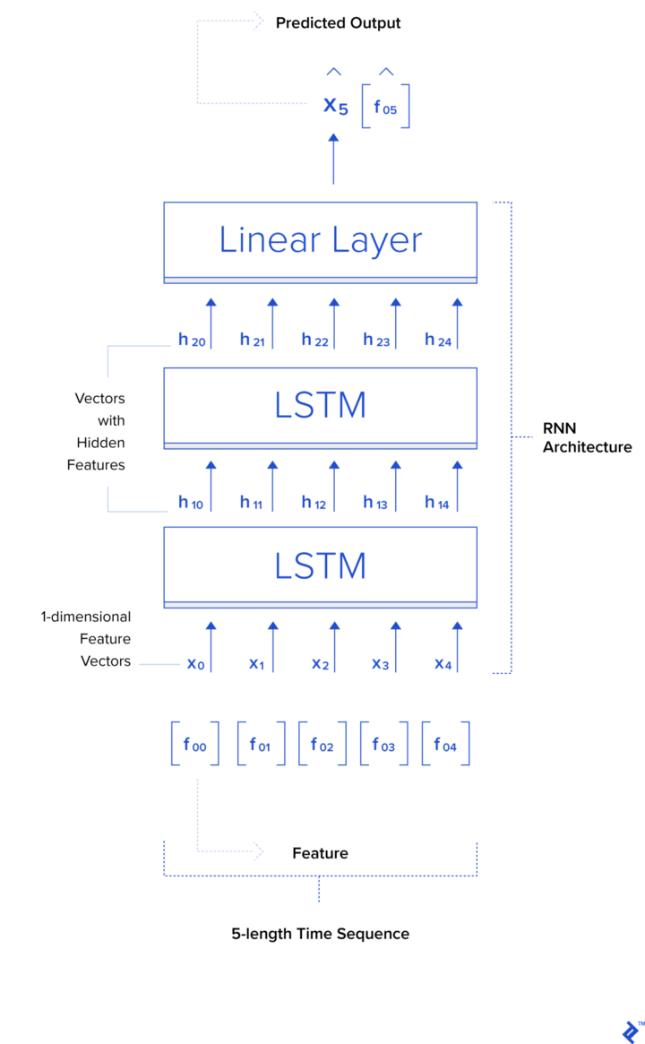
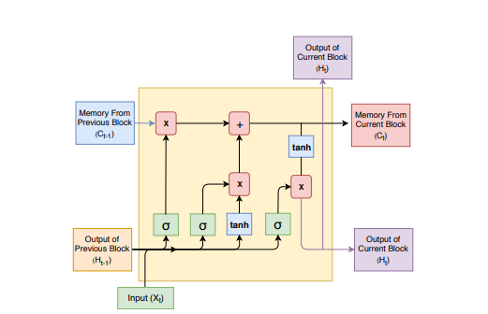
Long Short Term Memory (LSTM)
LSTM are also good at learning from sequential data, i.e. time series.

Slide 16
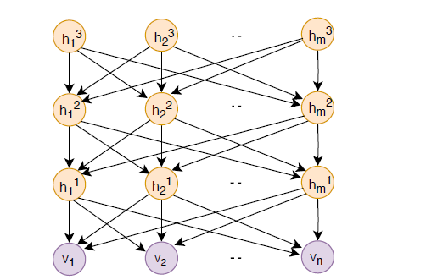
Deep Belief Networks (DBNs)

Slide 17
Part iII. HOW?
— Algorithmic trading is defined as buying and selling decisions made only by algorithms. The most important role of algorithmic trading can overcome the aversion of human nature to loss.
— Risk Assessment：Another study area that has been of interest to DL researchers is Risk Assessment which identifies the “riskiness” of any given asset, firm, person, product, bank, etc. Such as financial distress prediction to avoid choose the problem companies.This is part of Decision Support Systems.
— Portfolio Management is the process of choosing various assets within the portfolio for a predetermined period.This could be part of Financial / Invested Programmatic Trading or Decision Support Systems.
— Other Studies:Financial Sentiment Analysis and Behavioral Finance,Financial Text Mining,Theoretical or Conceptual Studies…
This could be part of any of Financial / Invested Programmatic Trading or Decision Support Systems .
Application domains
3

Slide 18
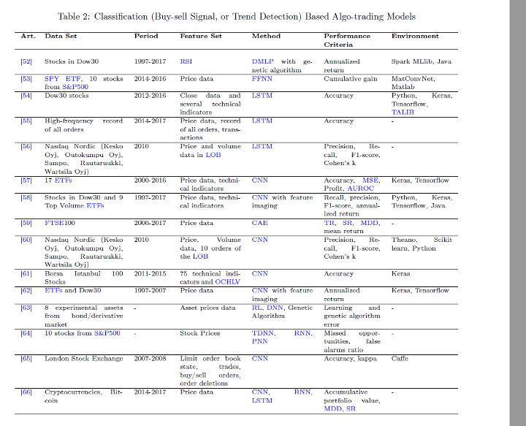
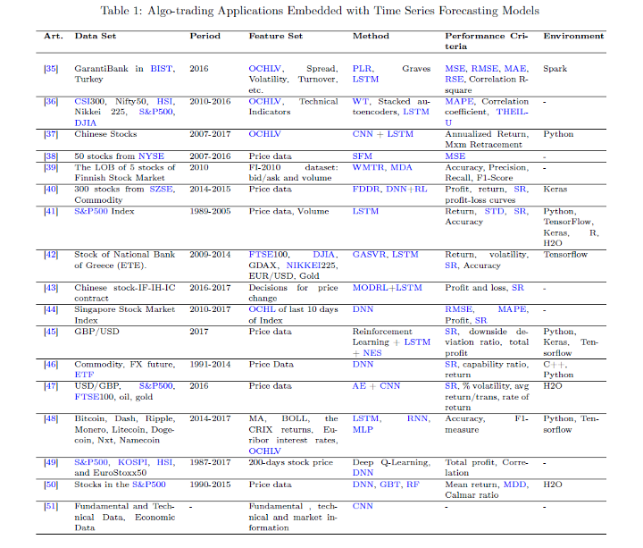
— Algorithmic trading
Here some cases used text mining to extract information from the tweets and financial news and used LSTM, RNN, GRU for the generation of the trading signals. This could be part of Decision Support Systems too.

Slide 19
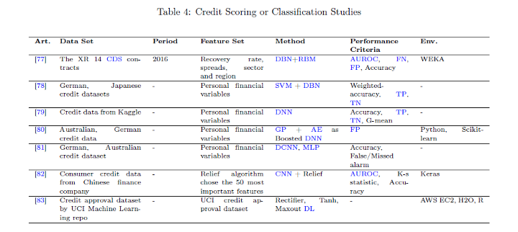
— Risk Assessment

Slide 20
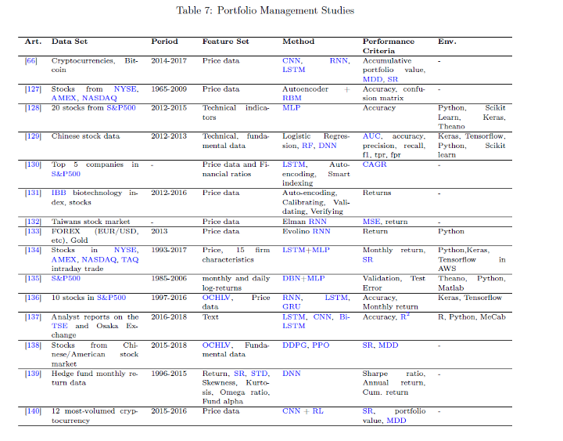
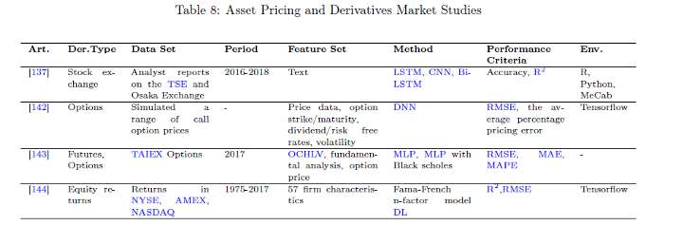
— Algorithmic trading
Asset Pricing and Derivatives Market (options, futures, forward contracts) could be a part of Portfolio Management.
Portfolio selection and smart indexing were the main focuses of and using AE and LSTM networks.[2]

Slide 21
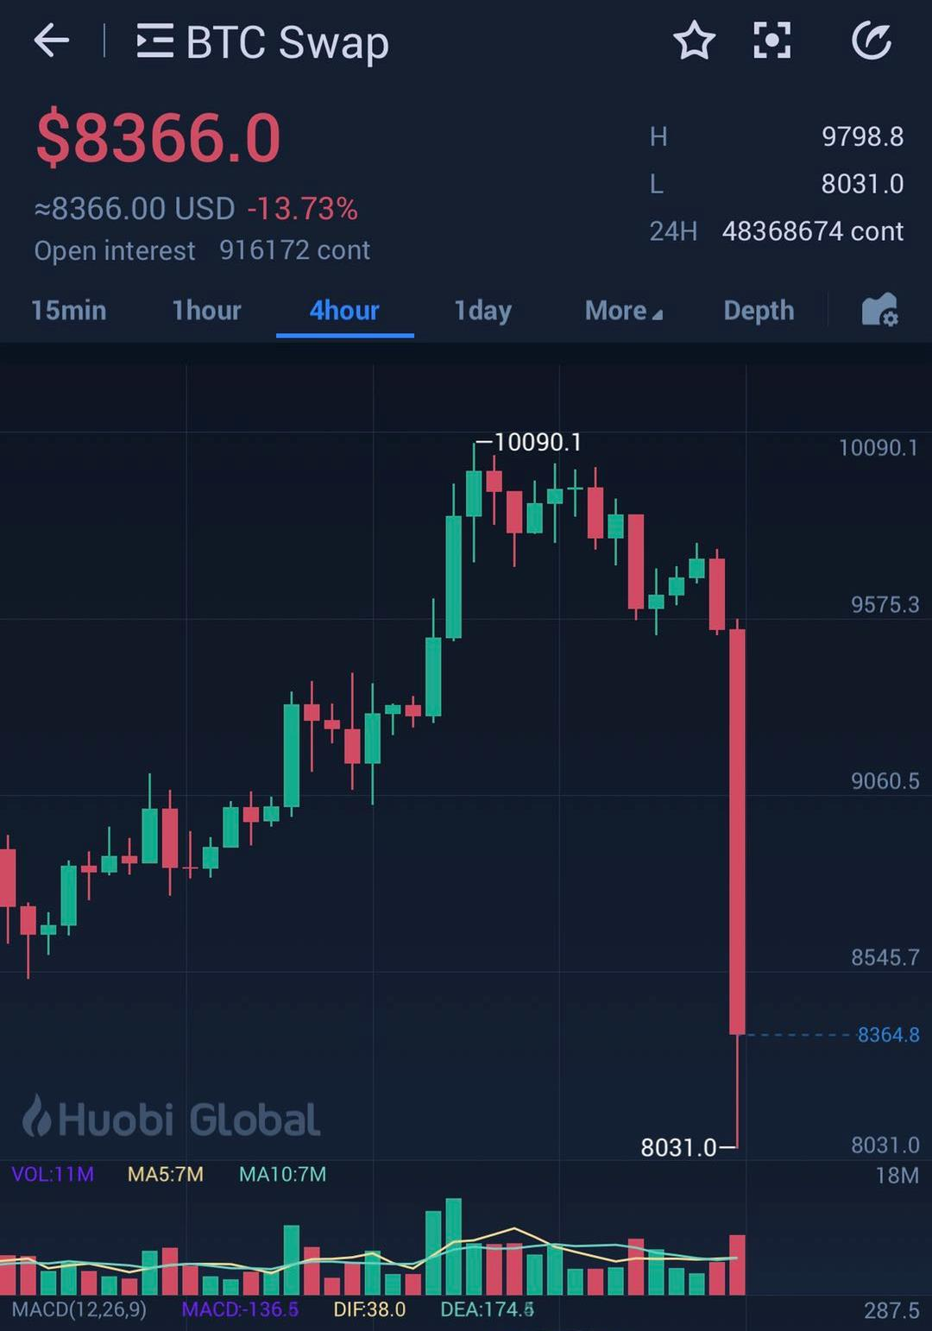
— Cryptocurrency and Block chain Studies:
As an early participant in the Cryptocurrency market, in my opinion, this market is very immature, the volatility is extremely large and the manipulation behavior is very serious. Participating in this transaction is actually no different from a casino.
I could suggest that only use a very small proportion of funds (such as 3% to 5% ) to participate, perhaps this market may reach a very high price, or it may return to zero, it is not worth using deep learning algorithms to research.
In this part, my opinion is far different from the opinion of the Survey.

Slide 22
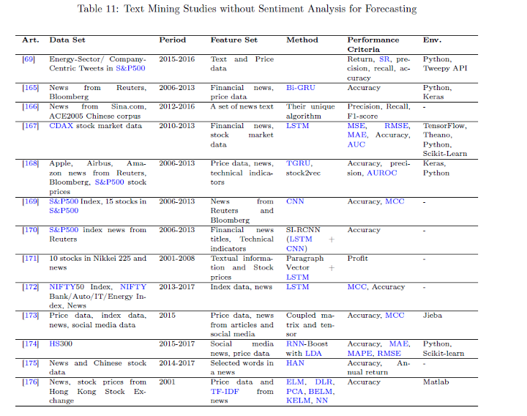
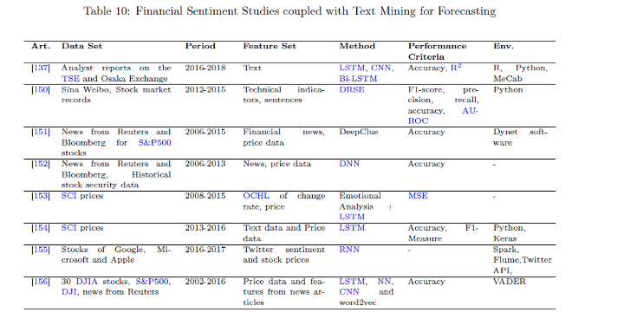
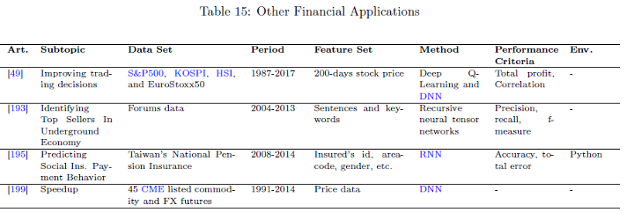
— Other Studies:
Financial Sentiment Analysis and Behavioral Finance
Financial Text Mining
Theoretical or Conceptual Studies
RNN(LSTM ),CNN should be the main methods.

Slide 23
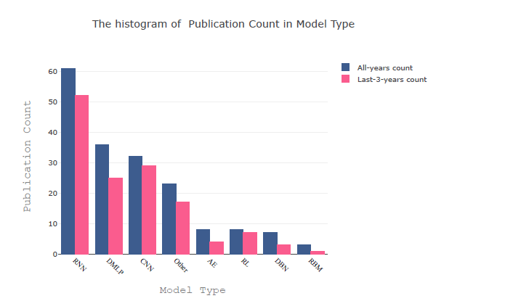
-- Summary:models
RNN, DMLP and CNN on the remaining models, because these models are the most commonly used models in general DL implementation
In RNN selection, most models actually belong to LSTM, which is very popular in time series prediction or regression problems. Also It is often used in algorithmic trading. Over 70% of RNN papers include LSTM model.
The hybrid model is preferred to go beyond the native model for better achievements. Many researchers configure topology and network parameters to achieve higher performance.

Slide 24
Part iii. How?
How to use DL in Finance / Investment ?
Explore innovation opportunities
Develop trading strategy;
Compare them;
Performance show;
4

Slide 25
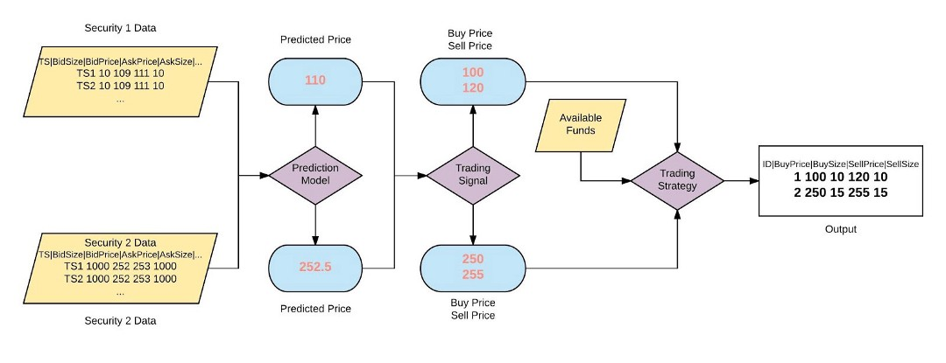
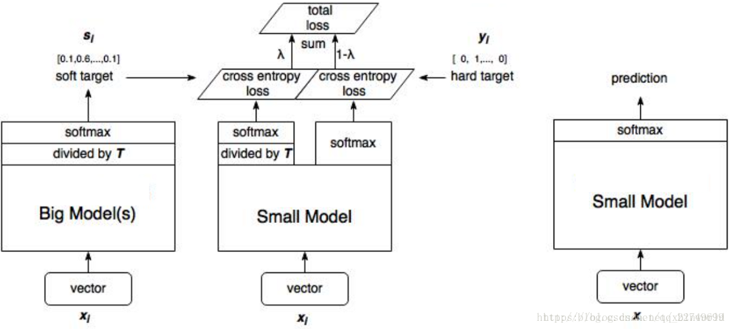
Strategies
* How to develop a trading strategy?
There are Various difficulties
- Scaling data to train the deep network. - Deciding on appropriate network architecture. - Tuning the hyperparameters of the network and optimization algorithm. - Dozens hyperparameters that affect the model. - Cost function. - Market data tends to be non-stationary
Notes:
How to develop a trading strategy?

Slide 26
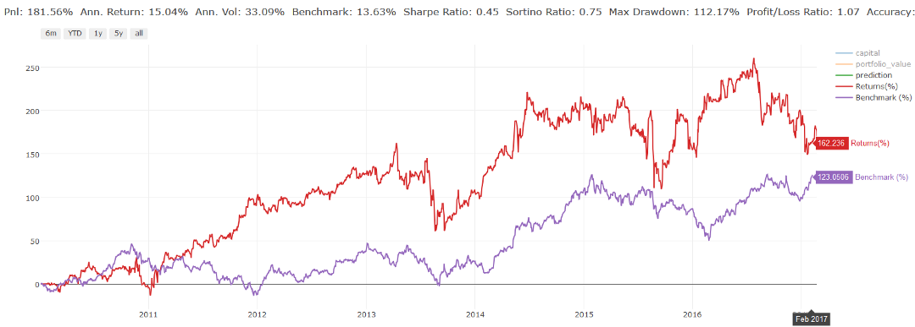
How do you compare different systems?
Strategies comparison
Some back-tester provides you with the following metrics to quantify your system’s performance. These set of metrics are not exhaustive, but they’re a good place to start:
Total Return
Annualized Return
Annualized Volatility
Sharpe Ratio
Sortino Ratio
Maximum Drawdown
% Profitability
Profit Factor
You can read in detail about them here.
Notes:
You can read in detail about them here.

Slide 27

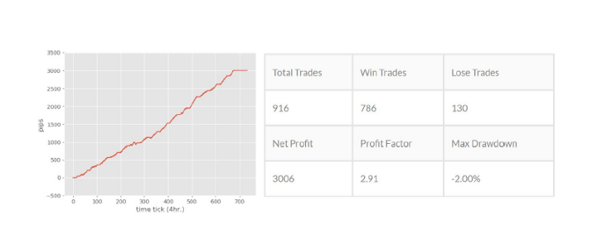
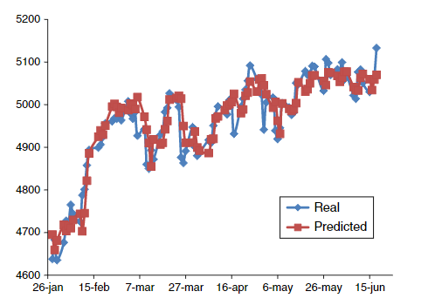
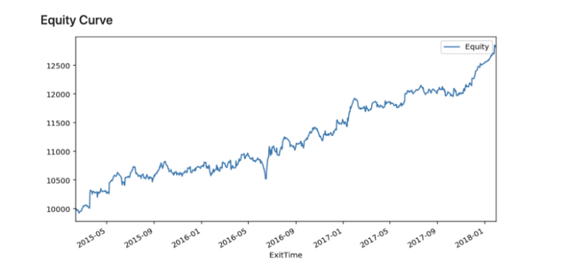
Performance of DL in finance:
Notes:
Deep Reinforcement Learning for Foreign Exchange Trading performance table
Deep Learning for Forex Trading

Slide 28
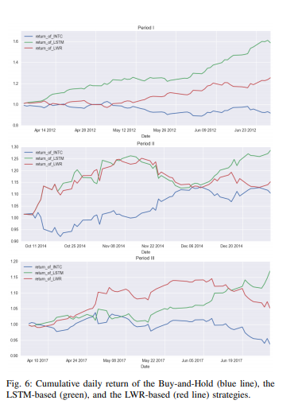
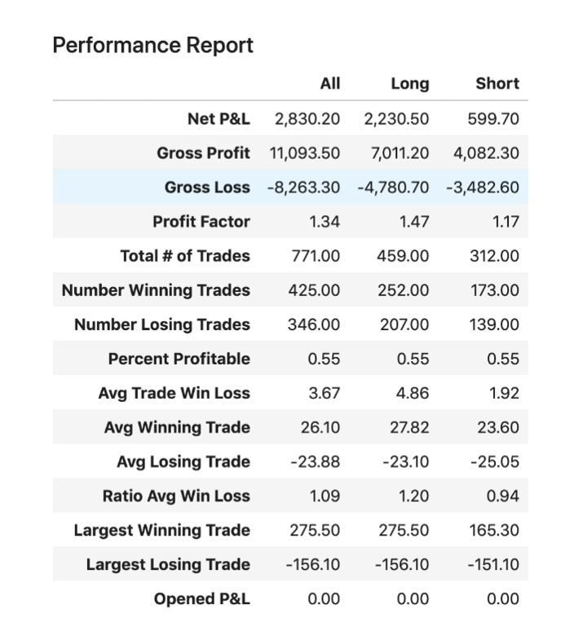
Performance of DL in finance:
It seems very exciting from the above introduction.
Notes:
Deep Reinforcement Learning for Foreign Exchange Trading performance table
Deep Learning for Forex Trading

Slide 29
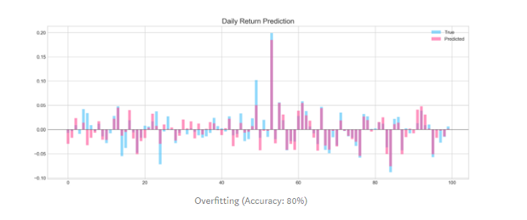
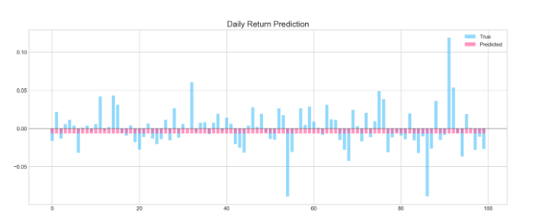
-- BUT
Sometimes, DL network was prone to overfitting in short-time,
meaning it learned patterns in the train data very well but failed to make any meaningful predictions on test data. Accuracy was as good as a random guess.
DL network was prone to overfitting in predicting the next day/week price

Slide 30
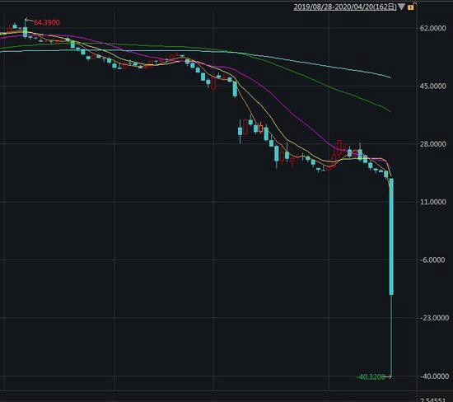
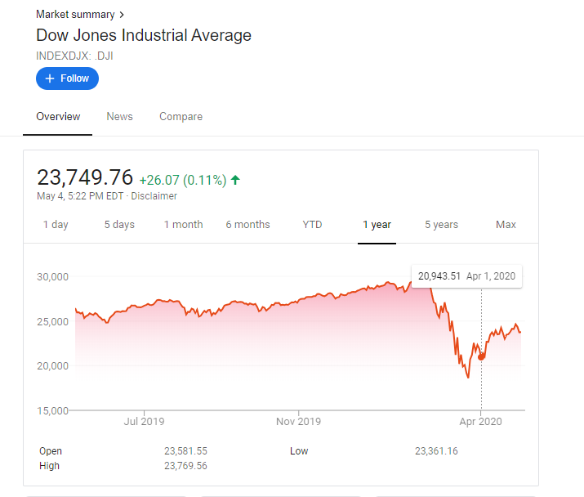
-- And… YOU NEVER KNOWN!
Over the years, the Black Swan incident has occurred from time to time.
@April 20th 2020 , Negative crude oil futures prices that have never happened in history
Three times a week Fuse.
Notes:
This Photo by Unknown Author is licensed under CC BY-SA-NC

Slide 31
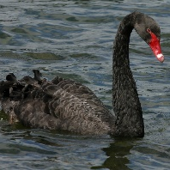
None of the above algorithms and models can handle such small probability events. If the position is not properly controlled, it will bring disastrous consequences, but if you keep the position at a low level, it is likely that you will not be able to obtain sufficient returns in the long run.
Sentiment
Bankrupt
Epidemic
The existence of irrational traders makes price bubbles inevitable, and sometimes causes various tramples due to excessive panic in the market.
“In the capital market, anything bizarre can happen. All you have to do is handle your own affairs, and strive to survive when the most bizarre events happen.--“The time the market remains irrational may continue until you go bankrupt.’
Three times a week Fuse and Negative oil prices.
In March and April 2020, we witnessed an extreme market that has never appeared in the history of investment, even Warren Buffett, who is already 90 years old never saw that.

Slide 32
-- Part iv: Conclusion
Deep Learning for Financial Applications:
- Financial text mining, Algo-trading, risk assessments, sentiment analysis, portfolio management and fraud detection are the most studied areas of finance research.
-Behavioral finance and derivatives market have promising potentials for research.
- RNN based models (in particular LSTM), CNN and DMLP have been used extensively in implementations. LSTM is more successful and preferred in time-series forecasting, while DMLP and CNN are better suited to applications requiring classification.

Slide 33
-- Part iv: Conclusion
Some important principles
Apart from god and scammers, no one can predict the short-term trend of the stock, even with the help of high-tech technologies such as machine learning and deep learning.
A crucial issue in investment activities: Certainty.
The lower the certainty, the less money can be used to participate. Once this principle is violated, it may be eliminated in a small probability event.
Machine learning and deep learning algorithms sometimes treat short-term historical data as random walks or white noise, but they are indeed important and sometimes produce terrible results. Fundamental analysis, Twitter analysis, news analysis, local / global economic analysis-things like this have the potential to improve forecasts.
Stock market is a very complex system, and historical data alone is not enough to explain its behavior.

Slide 34
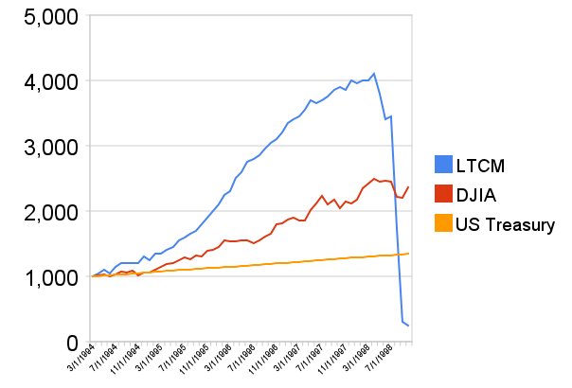
Always be careful
Resources：the story of long-term capital Management company
Notes:
see Resources, the story of long-term capital Management company

Slide 35
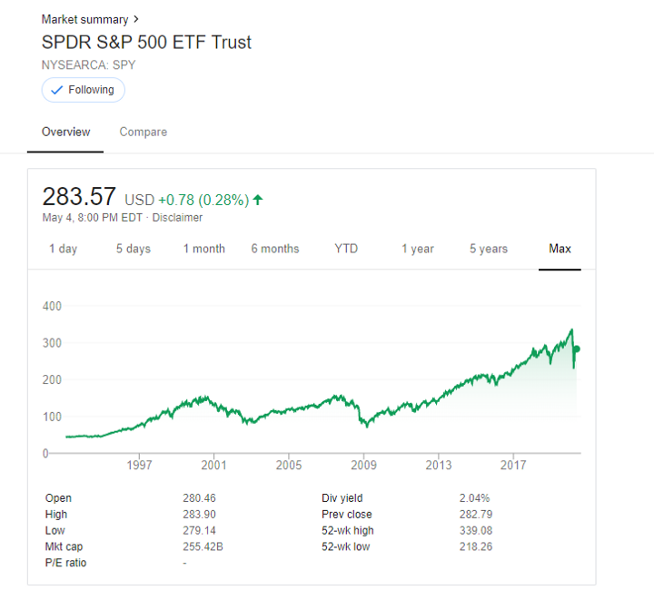
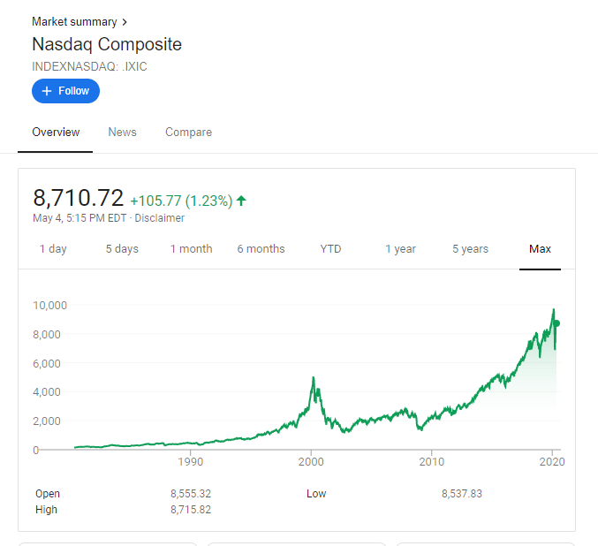
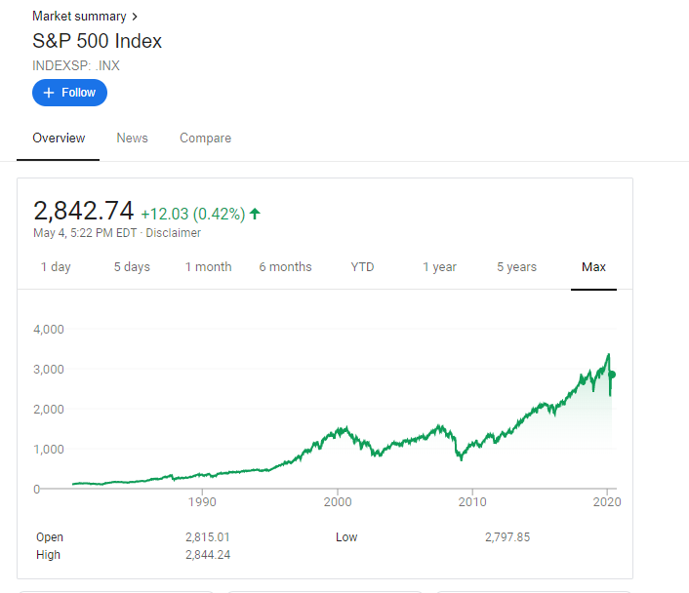
Conclusion
After all, in the long run, the stock market will always be slightly higher than inflation.

Slide 36
References:
[1] Value investing , https://en.wikipedia.org/wiki/Value_investing
[2] Deep Learning for Financial Applications: A Survey, https://arxiv.org/abs/2002.05786
[3] How is deep learning used in finance? https://www.quora.com/How-is-deep-learning-used-in-finance
[4] Application of Machine Learning Techniques to Trading, https://medium.com/auquan/https-medium-com-auquan-machine-learning-techniques-trading-b7120cee4f05
[5] Application of Deep Learning to Algorithmic Trading, http://cs229.stanford.edu/proj2017/final-reports/5241098.pdf
[6] Machine learning in finance: Why what & how, https://towardsdatascience.com/machine-learning-in-finance-why-what-how-d524a2357b56
[7] Create Your Own Trading Strategies, https://www.investopedia.com/articles/trading/10/create-trading-strategies.asp
[8] Machine Learning for Day Trading , https://towardsdatascience.com/machine-learning-for-day-trading-27c08274df54
[9] Introduction to Deep Learning Trading in Hedge Funds, https://www.toptal.com/deep-learning/deep-learning-trading-hedge-funds
[10] Deep Reinforcement Learning for Foreign Exchange Trading, https://arxiv.org/pdf/1908.08036.pdf
[11] Black swan theory, https://en.wikipedia.org/wiki/Black_swan_theory
[12] Long Term Capital Management, https://en.wikipedia.org/wiki/Long-Term_Capital_Management

Slide 37
Jacky Chow
SJSU MSSE-Data Science
jie.zou@sjsu.edu

